Slide 1
Collaborative Feature Modeling: A Voting Based Approach with Divergence Tolerance and Consensus Facilitation
Outline
1.15

Slide 2
Titles
1. Introduction
2. Preliminaries
2.1 CSCW
2.2 Feature Model
3. The Conceptual Framework
3.1 Meta-model of the Extended Feature Model
3.2 Operations on the Model
3.3 Views for the Model
4. The Coordination Mechanism
4.1 Overview
4.2 Activity-level Coordination
4.3 Feature-level Coordination
5. A Case Study
6. Related Work
7. Conclusions and Feature Work

Slide 3
Titles
1. Introduction
2. Preliminaries
2.1 Core Concepts of CSCW Systems
2.2 A Meta-Model of Feature Models
3. The Conceptual Framework
3.1 The Meta-model of Extended Feature Models (EFMs)
3.2 Operations on EFMs
3.3 Views for EFMs
4. The Coordination Mechanism
(Overview)
4.1 Activity-level Coordination
4.2 Object-level Coordination
5. A Case Study
6. Related Work
7. Conclusions and Feature Work

Slide 4
Main Parts with Explanation
2. Preliminaries
2.1 CSCW
2.2 Feature Model
3. The Conceptual Framework
3.1 Meta-model of the Extended Feature Model
3.2 Operations on the Model
3.3 Views for the Model
4. The Coordination Mechanism
4.1 Overview
4.2 Activity-level Coordination
4.3 Feature-level Coordination
5. A Case Study
( Including a brief introduction to our tool)
6. Related Work
Traditional Feature Modeling
Collaborative Ontology Construction
Collaborative Requirements Elicitation and Modeling
Collaborative Feature Modeling
Core Concepts of CSCW Systems
Production
Coordination
Awareness
Communication

Slide 5
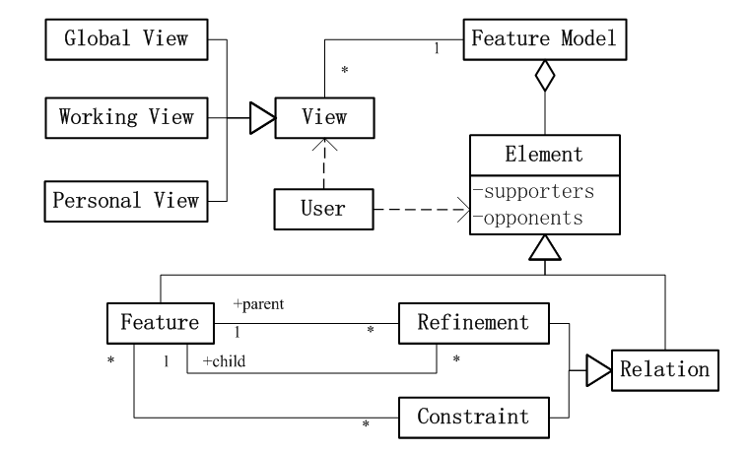
Meta-Model of the Extended Feature Model
Create
Vote

